Slide 1
Lesson Nine
Food allergies, food intolerance and coeliac disease

Slide 2

Discuss
How can you tell if someone is having an allergic reaction?
What are the symptoms of anaphylactic shock?
How can you tell if someone has a food intolerance or coeliac disease?
Notes:
How can you tell if someone is having an allergic reaction?
Coughing
Dry itchy throat and tongue
Wheezing and breathlessness
Runny nose
Itchy eyes
Flushing of the skin
Abdominal pain, nausea and vomiting
A red or raised rash anywhere on the body
Swelling, especially of the face, lips, tongue and throat
Changes in heart rate
Feeling bloated
What are the symptoms of anaphylactic shock?
Intense fear
A rapid fall in blood pressure
Rapid heartbeat
Breathlessness/ difficulty breathing from severe asthma
Collapse and unconsciousness
Swelling of the throat and mouth resulting in difficulty swallowing
Anaphylaxis is a medical emergency. If you ever encounter someone experiencing an anaphylactic shock, seek medical assistance immediately. Anaphylactic shock can kill within a matter of minutes.
How can you tell if someone has a food intolerance or coeliac disease?
Stomach pain, nausea or diarrhoea
Wind or bloating
Headache
Flushing or skin rash
Wheezing
Symptoms are usually not immediate and tend to be less severe than those associated with an allergic reaction.

Slide 3
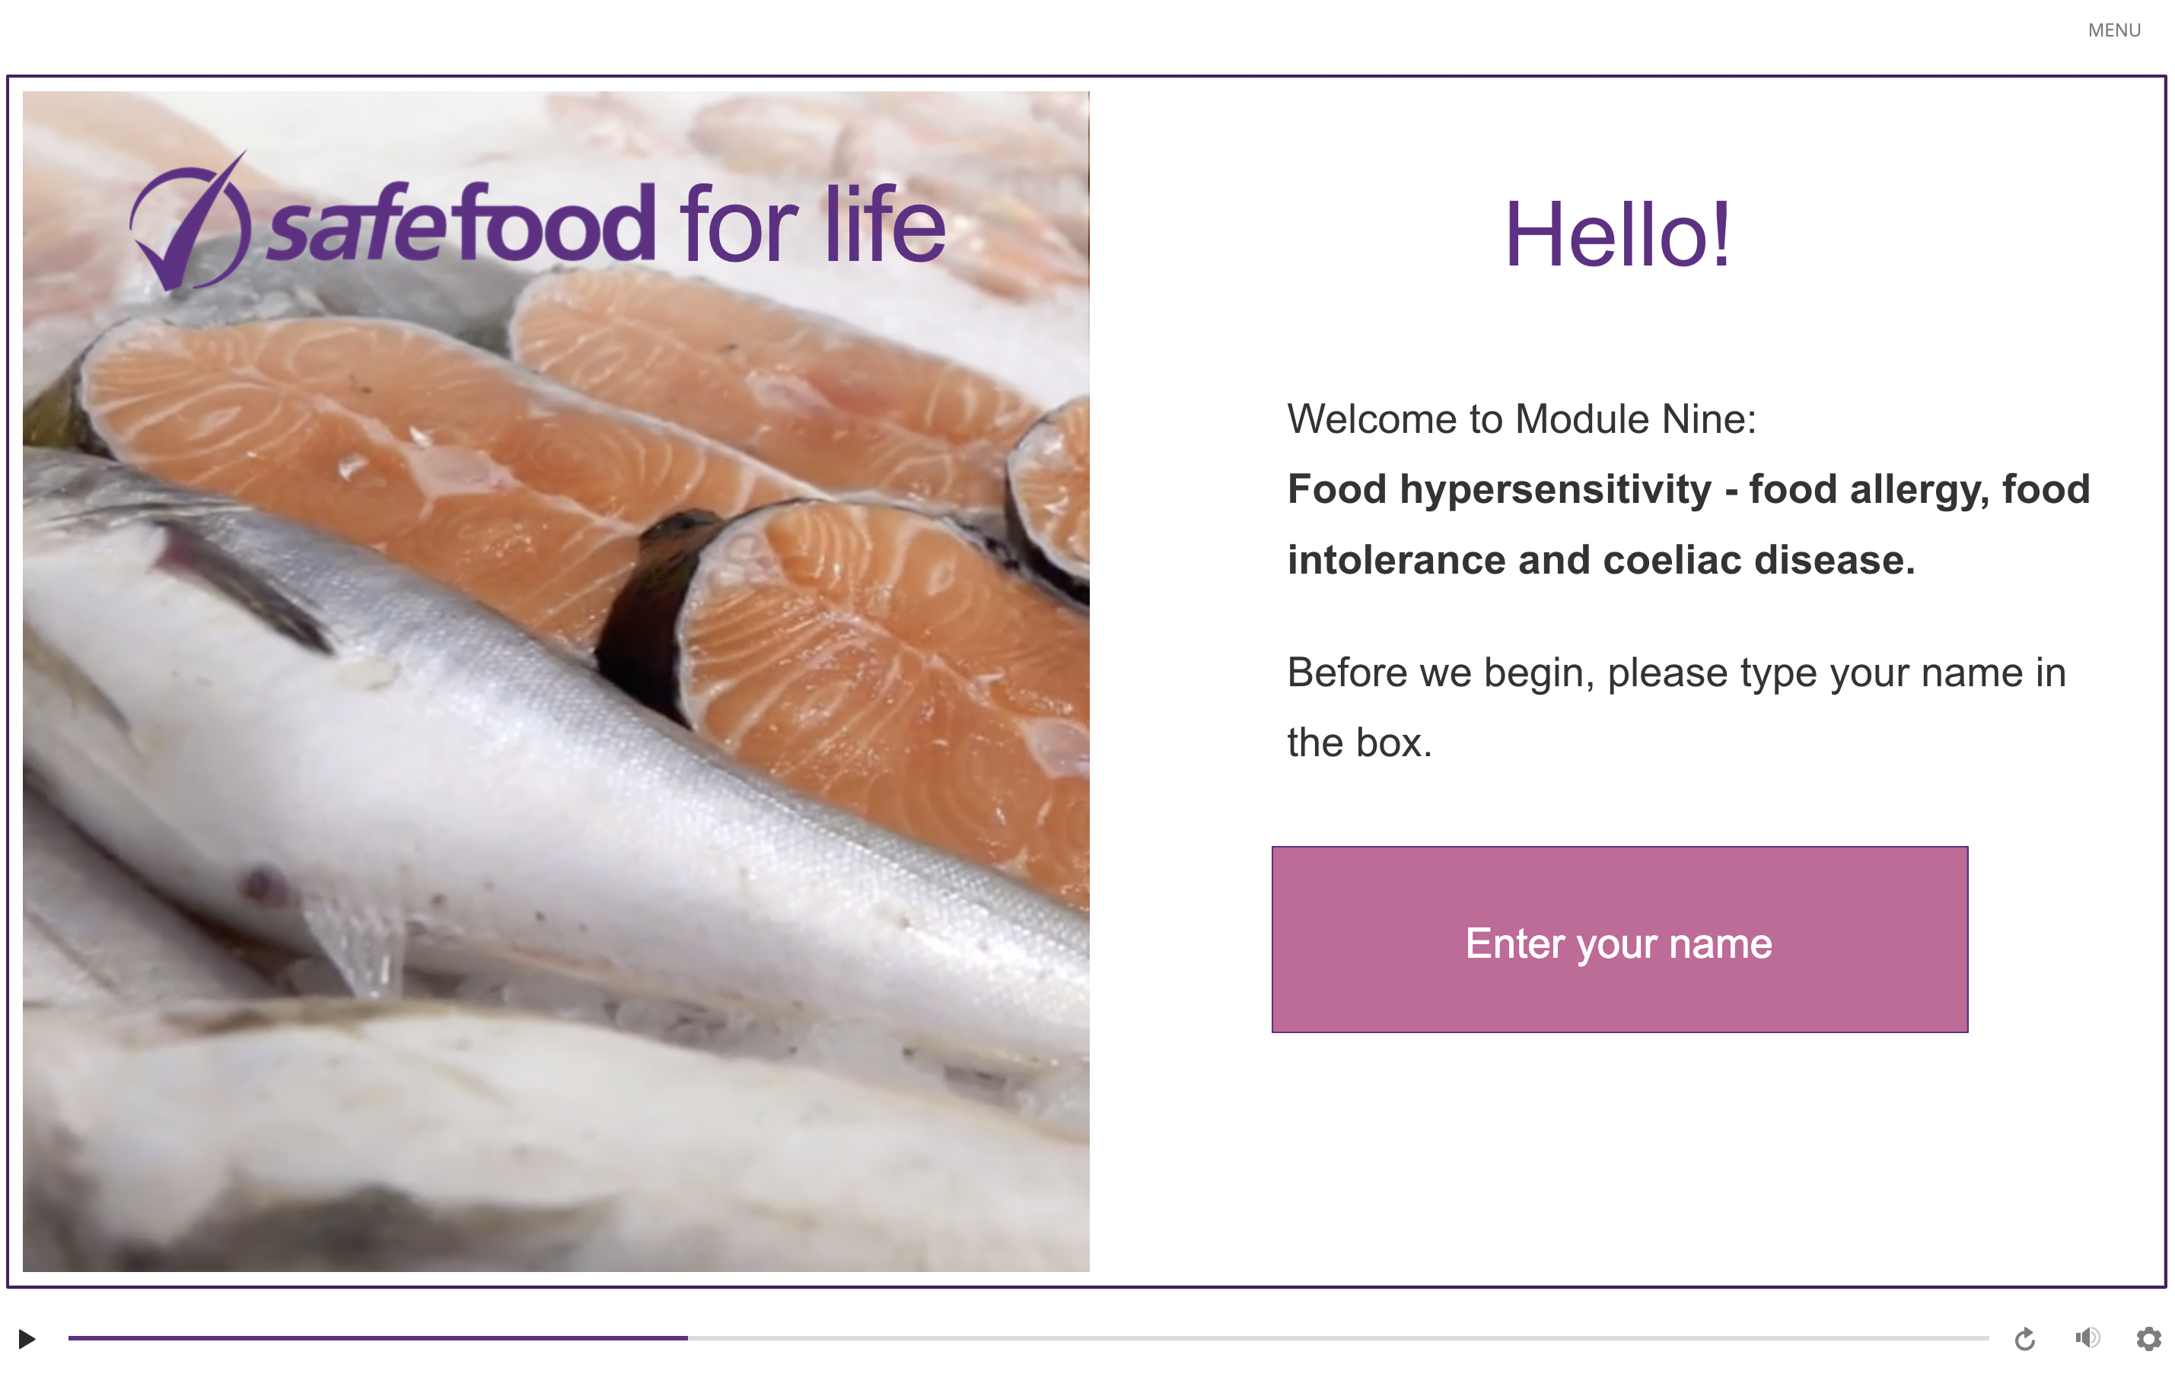
eLearning module

Slide 4
In class task
Use these resources to learn more about food allergies, food intolerance and Coeliac disease. Take notes and summarise key findings.
https://www.safefood.net/getattachment/c7d7a4ef-2263-486a-bde2-4709141142e2/Food-Allergy-Intolerance-Guide.pdf?lang=en-IE
https://www.youtube.com/watch?v=xguyPDTD9uE&list=PLh7gvGGhPbb0sg1xn42sXWt28u-LQ4gUV&index=2 https://www.safefood.net/allergens/catering-guide

Slide 5
Homework task
Research:
  How can you help your customer if you know they have a food intolerance or coeliac disease?
  How can you help your employer with food allergies, food intolerance and Coeliac disease?
Notes:
How can you help your customer if you know they have a food intolerance or coeliac disease?
If you are a waiter/waitress and your customer needs to avoid certain foods, let them know that you would be happy to discuss their requirements with them. Use tact and discretion as some customers may feel uncomfortable or embarrassed about discussing their dietary needs in public.
The customer may ask you about the possibility of cross-contamination (which is a big worry for people with food hypersensitivity). This can be tricky; if you’re not sure of the answer don’t second guess. Call either the head waiter/designated staff member/manager/chef etc. to deal with this query.
The customer may want to know if there were any ‘May contain’ statements on any of the ingredients for a particular menu choice. You should always tell them of any ingredient with a ‘may contain’ advisory so they can make an informed decision. And if you don’t know, then find out from someone who does. If necessary, show the customer your recipes or packet labels and tell them what steps the kitchen take to avoid cross-contamination. Remember: if you are unsure of any of the ingredients, or if there is any doubt about cross-contamination, you must tell the customer. The final decision to buy rests with them.
The customer may ask for a gluten-free meal; however as a food business you cannot use this term unless you know the exact amount of gluten. In a catering environment this is rarely the case so best avoid saying something is gluten-free unless it is a pre-packed food bought in and already labelled as gluten-free. Point out the menu items that don’t have ‘cereals containing gluten’ as ingredients.
How can you help your employer with food allergies, food intolerance and Coeliac disease?
If you are responsible for any notices or other information concerning allergen ingredients, make sure the information is clear, accessible and easy to read.
Some establishments have a designated member of staff to handle all food allergen and related queries. Be sure you know who this is (and who the back-up person is, in case they are not on duty). Bring all allergen-related queries to their attention.
If there are any changes to the menu on the night then ask if the allergen information should be changed as well. Sometimes the chef will need to change the ingredients of a dish for whatever reason. If this involves the introduction of new allergens then this needs to be communicated to the staff front of house.
If you are working in a catering kitchen, be aware of how allergenic foods are stored. Some kitchens may use sealed containers, colour coding, dedicated utensils, etc. for managing allergens and cooking for food hypersensitive customers.
Remember allergens are proteins and very sticky! If you are asked to clean utensils to prepare an allergen free meal, be sure and wash these thoroughly with detergent, hot water and plenty of elbow grease.
Be careful to avoid cross-contamination of allergens from one dish to another. This is a big problem for your food hypersensitive customers. An example would be the ice-cream scoop. If this has been used for hazelnut ice-cream and then for vanilla without being properly cleaned in between, then the vanilla ice-cream probably now has hazelnut protein as a contaminant and is unsafe for a nut allergy sufferer. Also, if you have gluten-free food and regular food on the same display, ensure the gluten-free food is wrapped so it cannot be contaminated.

